Slide 1

END TERM PROJECT

Slide 2
Details
Edit Data
View Data
Preview
Register
Home
Employee
DeleteDetails
Login
Customers
Contact
Details
DeleteDetails
Send Message
About
Location
View Data
Add Details
Edit Data
Information About Hotel

Slide 3
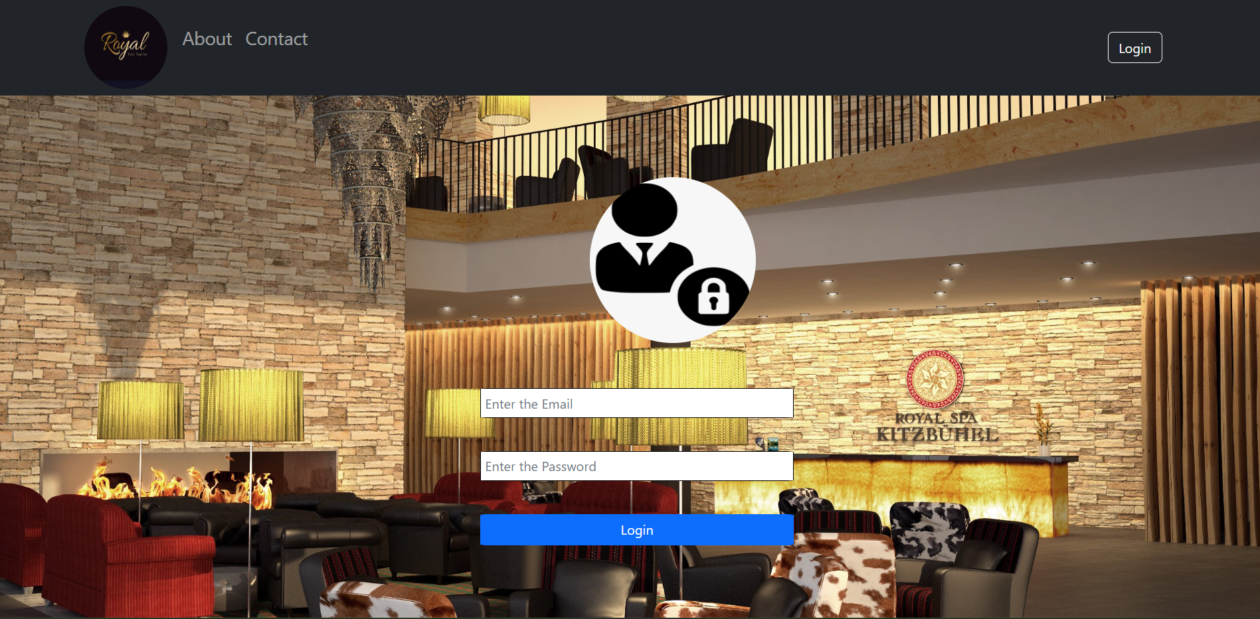
Login Page
There is validation in Email and password . We have to enter a valid Email or Password for accessing the details.

Slide 4

Home Page
Home page contains preview images, and at the top that navbar containssome links which are Customers ,Employee, About and Contact us.

Slide 5
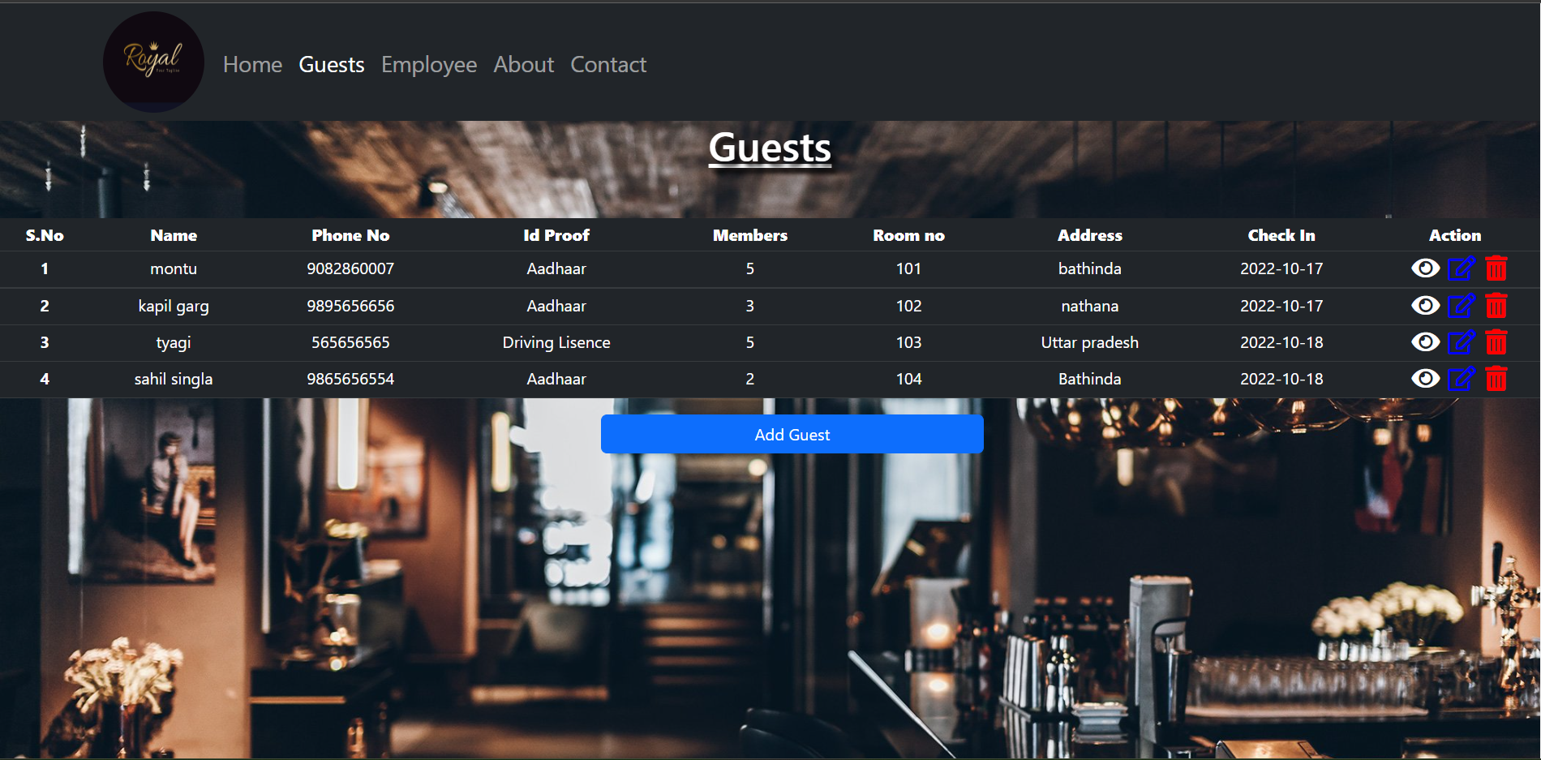
Guest Details
Guest page stores the data of guest. There is an action to view , edit or delete the details of guests . We can also add new customer by adding their details.

Slide 6
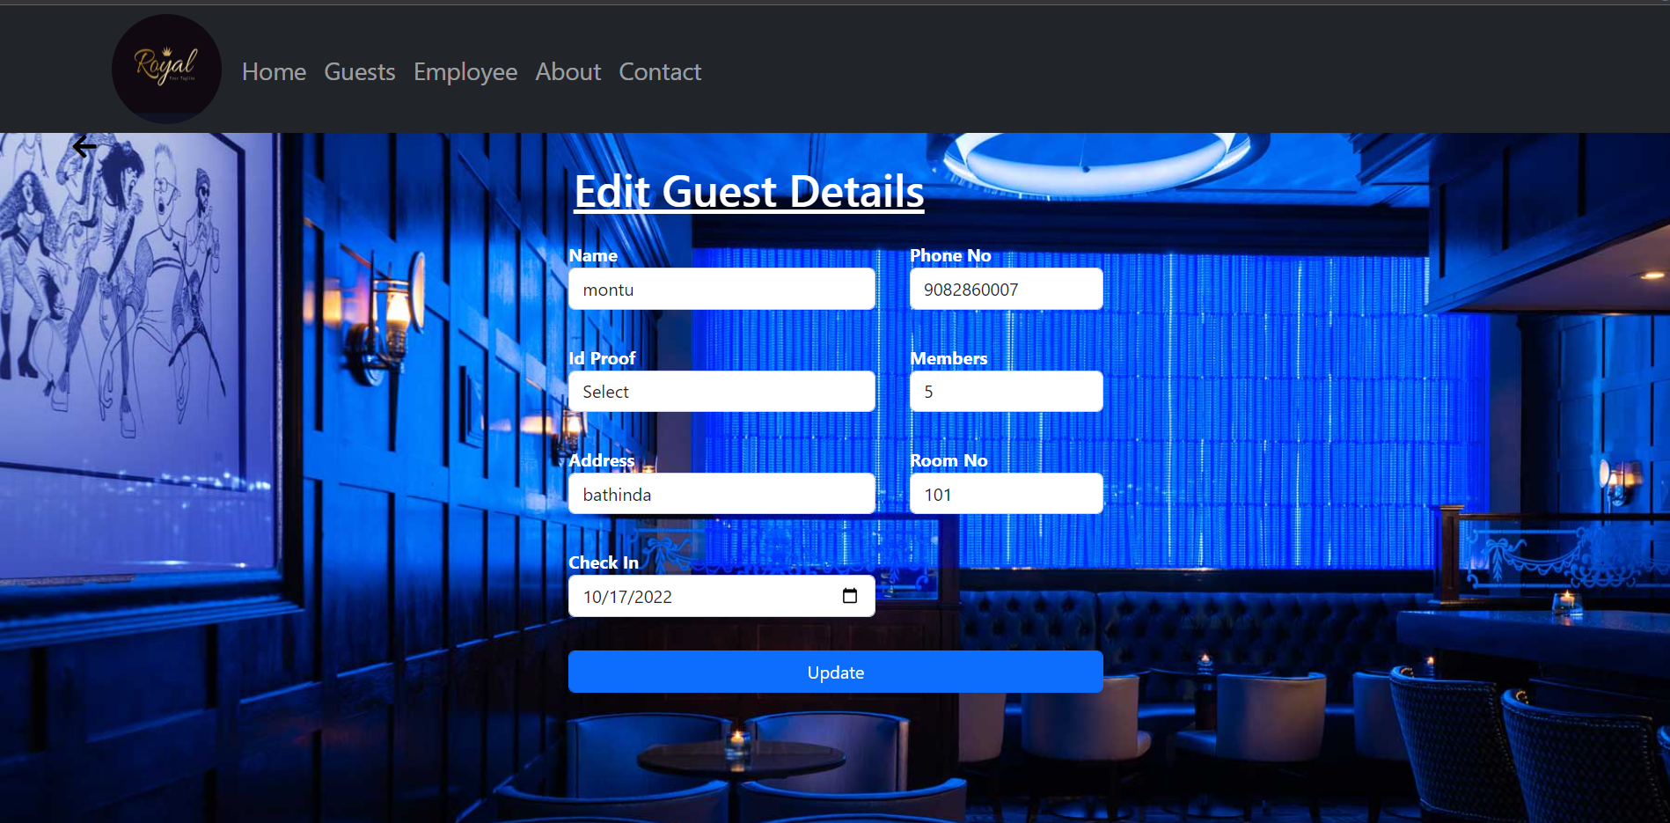
Edit Guest Details
Here we can add the detail of guests.

Slide 7
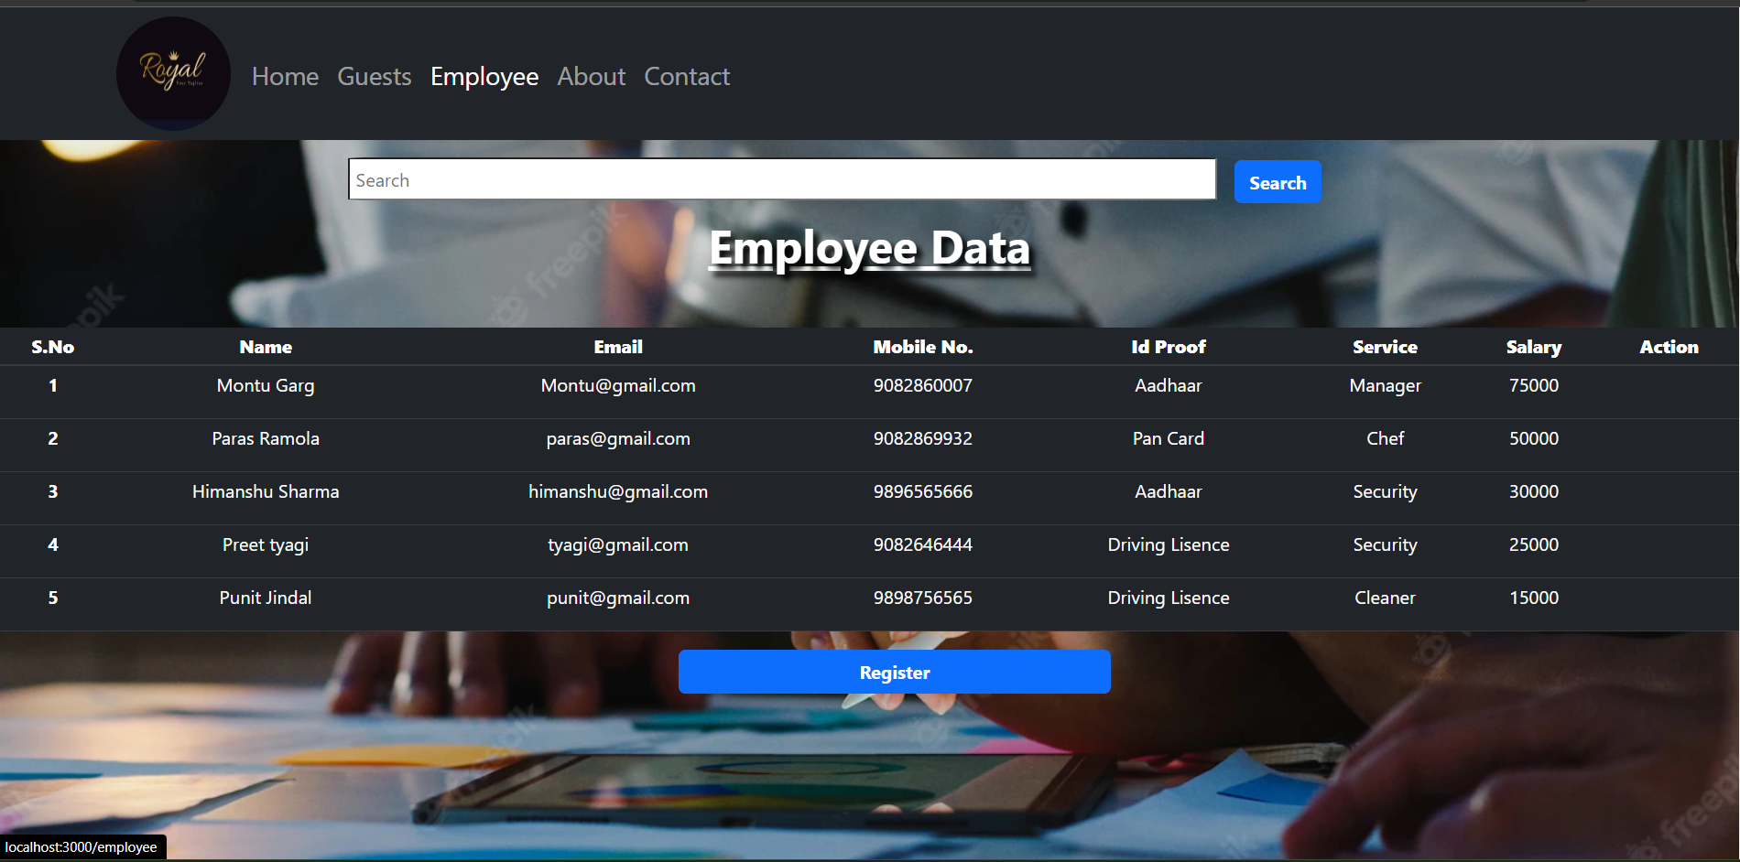
Employee Data
This page stores the data of employees . There is an action button which is used to view , edit or delete the details of an employee . We can also add new employee by clicking on the button named Register . There is search button at top used to search an employee by their Name or Email .
NOTE: Action button is also available in Customer Page and do the same job as in this page.

Slide 8
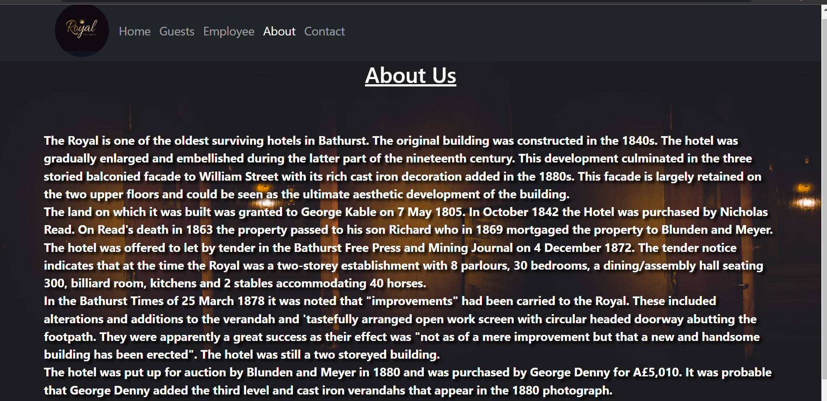
About
This page contains some basic information about our hotel.

Slide 9
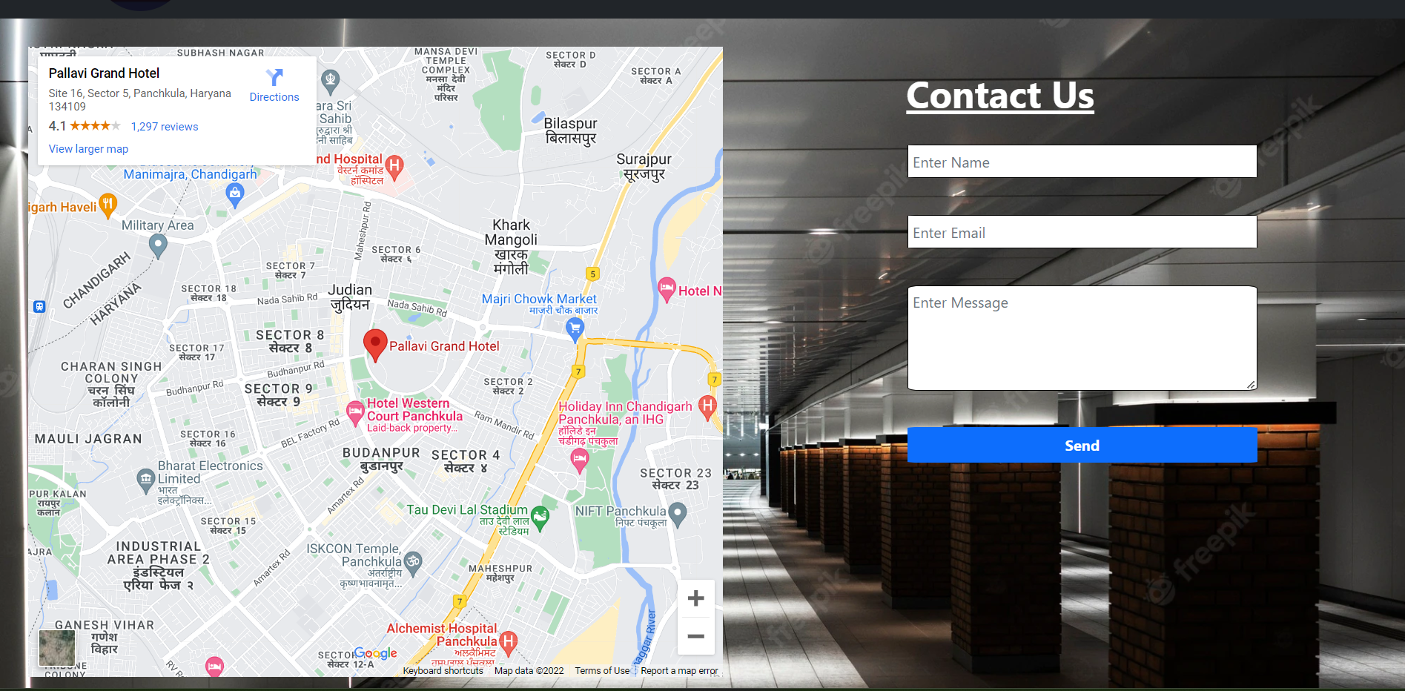
Contact Us
We provide map on this page so that you can find our hotel easily. Also we provide a form so that if you want to send us query you can do that through this form.

Slide 10
THANK YOU
Paras Ramola(2010990892)

